Slide 1
CAMPUS MAP

Slide 2
REQUIREMENT ANALYSIS
Step 1: Identifying end users.
End users:
Students
Faculty and Staff
Visitors

Slide 3
REQUIREMENT ANALYSIS
Step 2: Capturing Requirements.
One to one interviews:
Question: How often do you use maps or navigation apps on your phone?
Insight: Participants use maps on their phones frequently for various purposes, indicating a reliance on digital navigation tools.

Slide 4
REQUIREMENT ANALYSIS
One to one interviews:
Question: What features do you find most useful in a map or navigation app?
Insight: Commonly cited features include clear directions, real- time traffic updates, the ability to search for specific locations.
Question: Can you recall a recent time when you had difficulty finding a location on a map or navigation app?
Insight: Some participants experienced challenges with unclear directions or inaccurate map data.

Slide 5
REQUIREMENT ANALYSIS
One to one interviews:
Question: How important is it for you to have access to a campus map app for navigating around your university?
Insight: Participants expressed a strong need for a campus map app to navigate the university grounds efficiently.
Question: What specific information would you expect to find on a campus map app?
Insight: Expected features include building names, department locations, parking areas, and points of interest like cafeterias and libraries.

Slide 6
REQUIREMENT ANALYSIS
One to one interviews:
Question: Would you like to receive notifications about campus events through the map app?
Insight: Participants welcomed the idea of receiving notifications through the map app as a convenient way to stay informed.
Question: How satisfied are you with the current campus map or navigation resources?
Insight: Satisfaction levels varied, with some expressing moderate satisfaction and others identifying areas for improvement.

Slide 7
REQUIREMENT ANALYSIS
Step 3: Categorizing Requirements.
Functional Requirements:
Interactive Map Interface
Location Services
Building information
Points of Interest
Navigation and Directions
Search Functionality
Accessibility features

Slide 8
REQUIREMENT ANALYSIS
Non Functional Requirements:
Usability
Performance
Security
Scalability
Accessibility
Reliability

Slide 9
USER ANALYSIS
PRIMARY USERS:
Students
Faculty and Staff
Visitors

Slide 10
USER ANALYSIS
User Interface Requirements:
Attributes | Requirements
Display mode | Standard view
 | Day/Night mode
 | Custom theme
Layout | Clear and Intuitive design
 | Search bar- at the top
 | Map displaying area- large portion
 | Navigation controls- top and bottom

Slide 11
USER ANALYSIS
User Interface Requirements:
Attributes | Requirements
Paging | Swipe left or right
 | Sectional Navigation
 | Continuous Scrolling
Colors | Background- light neutral colors
 | Text and labels- black, white
 | Buttons and Interactive element- blue
 | Map elements- distinct colors

Slide 12
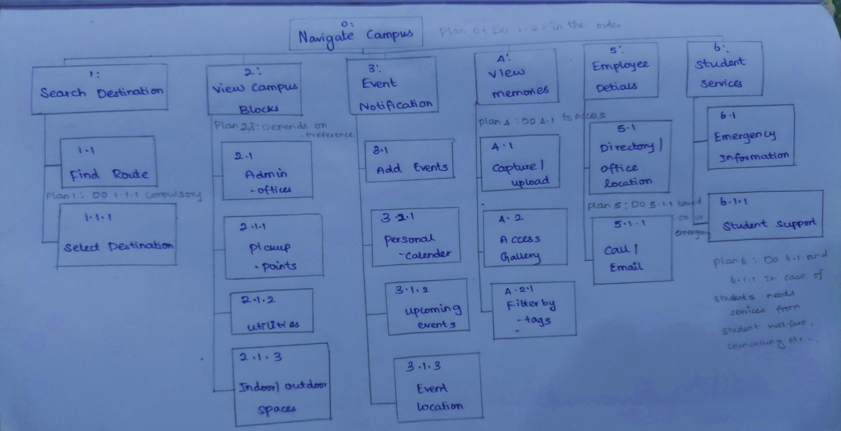
HIERARCHICAL TASK ANALYSIS

Slide 13
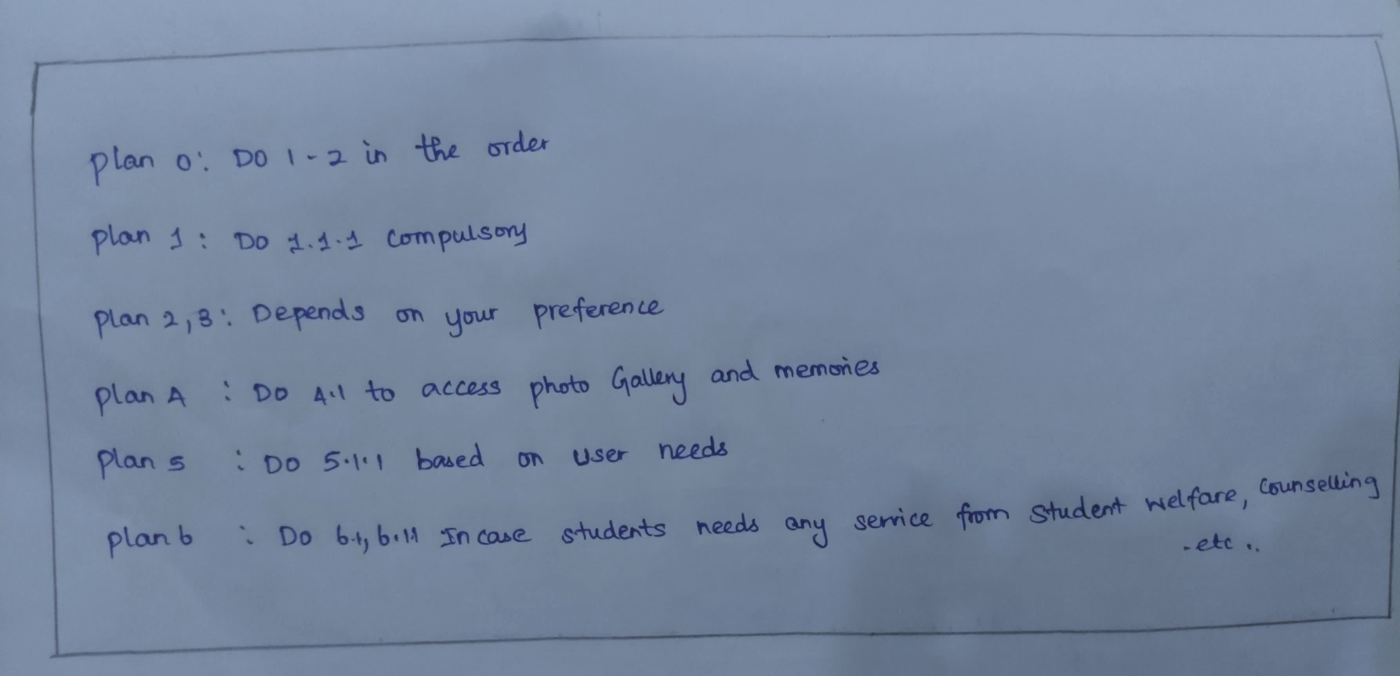
HIERARCHICAL TASK ANALYSIS

Slide 14
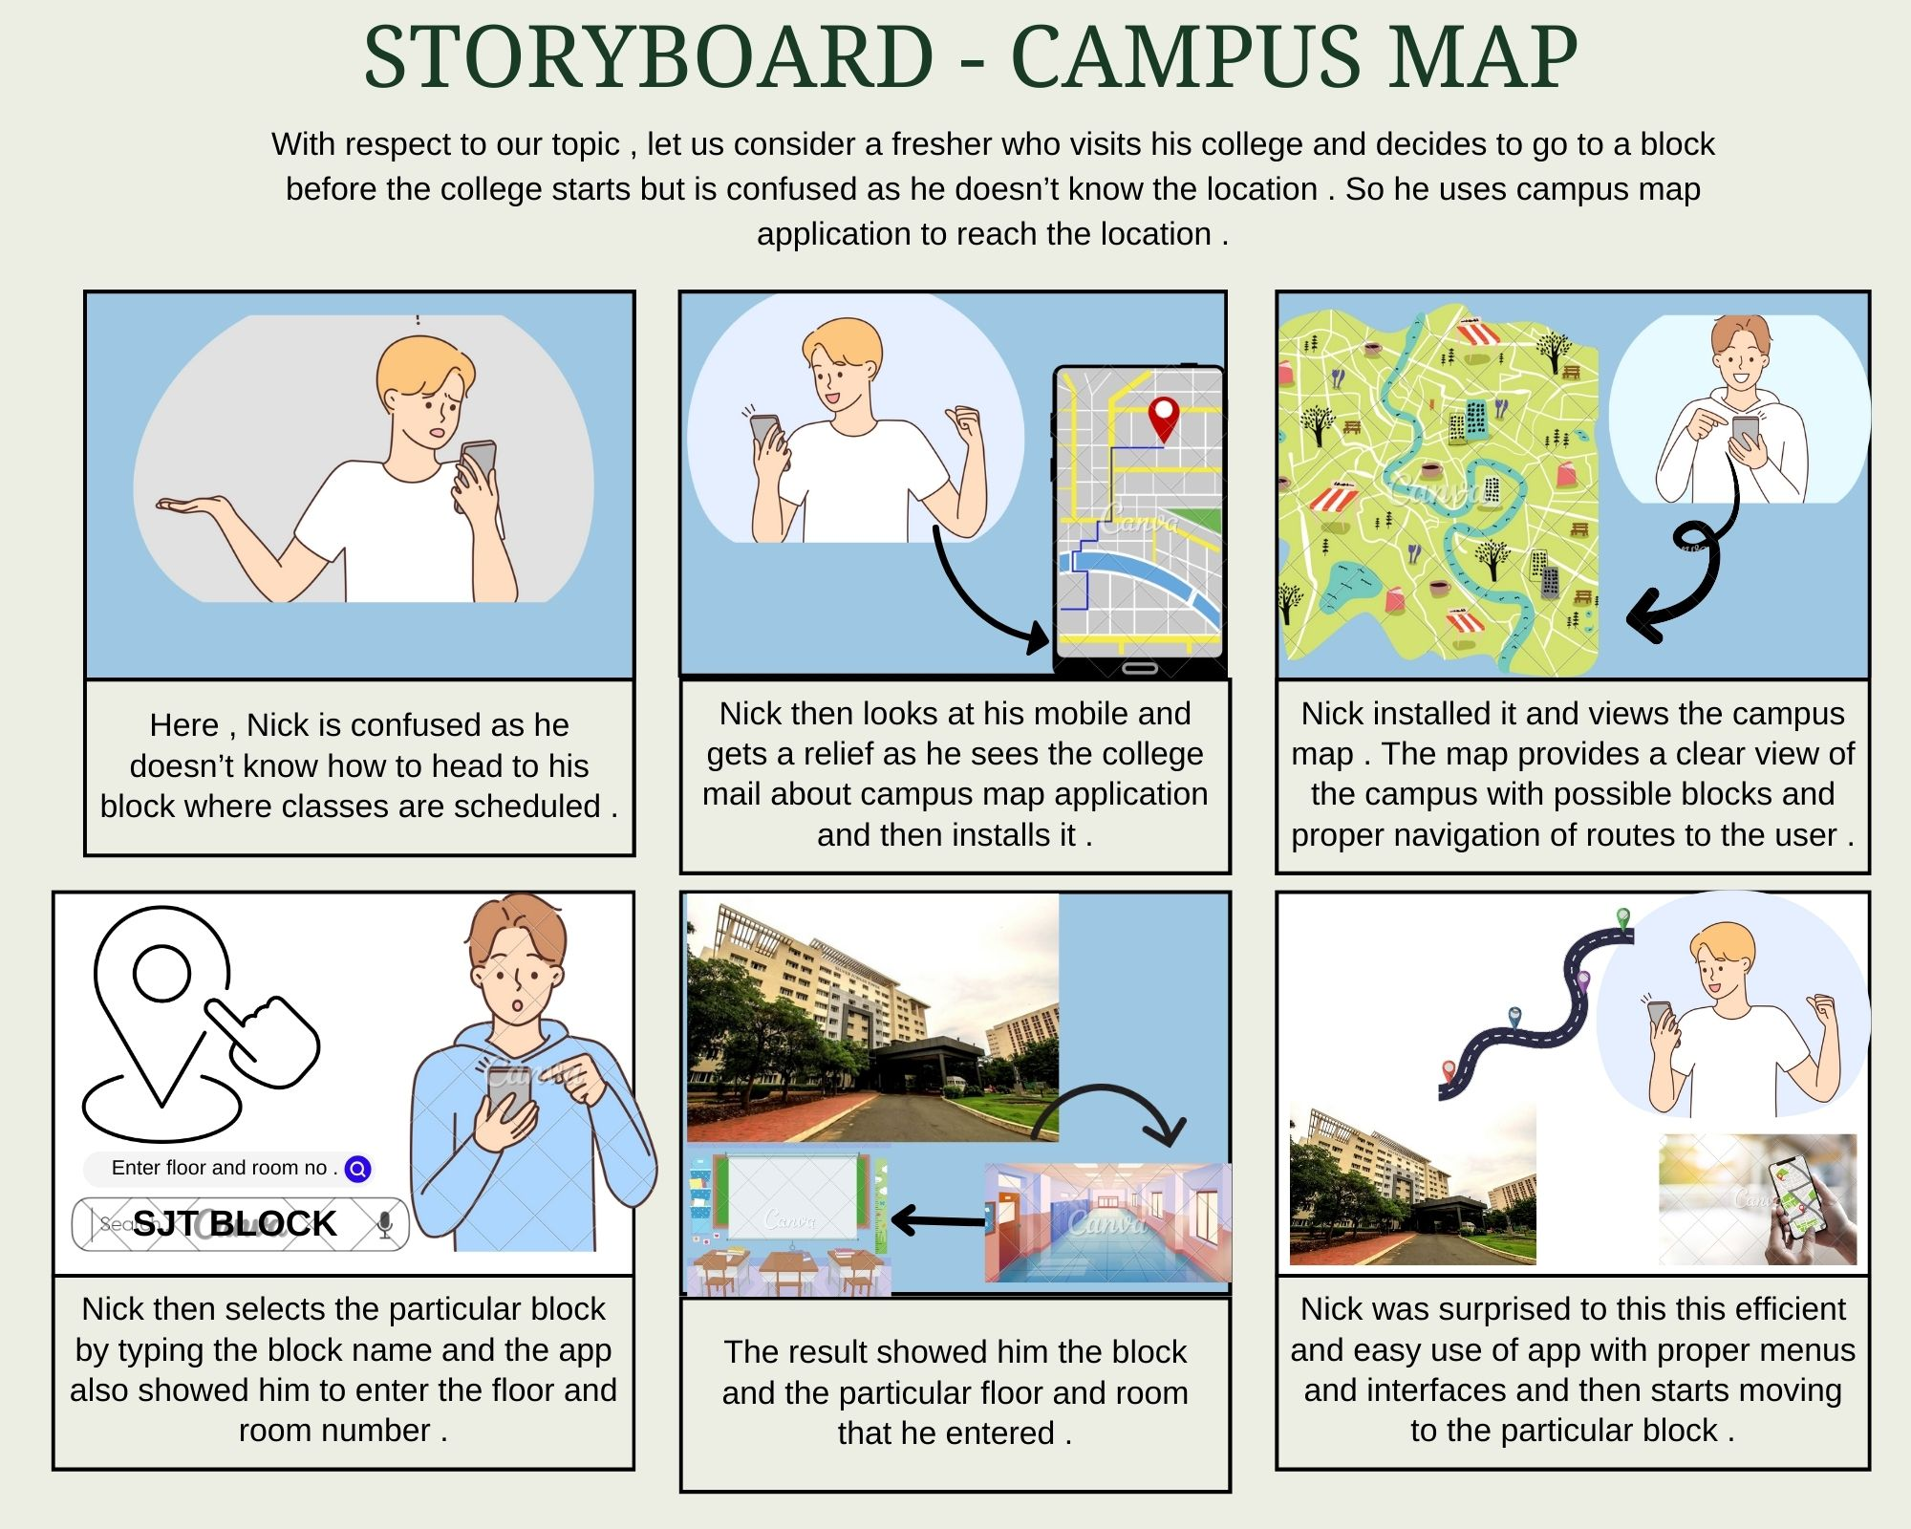

Slide 15
INTERFACE SELECTION
Sub task | Interface Design | Justification
Search Destination | Touchscreen | Some users may prefer tactile interaction with a touchscreen, combined with audio feedback for confirmation and assistance in selecting their destination.
 | Voice Command Input | Voice input provides a hands-free approach, allowing users to select their destination without needing to navigate through the interface.
Route Guidance | Touchscreen | Provide tactile interaction with a touchscreen to navigate through the directions of destination.

Slide 16
INTERFACE SELECTION
Sub task | Interface Design | Justification
Route Guidance | Audio Instruction | Audio instruction provide directional cues helping users understand the layout of their surroundings and navigate effectively without needing to focus on a screen.
Search Events | Touchscreen | Provide tactile interaction with a touchscreen to view various events.
View Memories | Touchscreen | Provide tactile interaction with a touchscreen to view the memories (photos taken at that location).

Slide 17
THANK YOU

